Slide 1

Simulating Inter-VM Data Exchange in Cloud Computing
This presentation explores simulating and optimizing data exchange between virtual machines.
We focus on system-to-system virtualization and application virtualization in cloud environments using CloudSim.

Slide 2


Cloud Computing and Virtual Machines
Role of VMs
Challenges
Virtual machines run applications and process data in cloud systems.
Data sharing faces latency, security, and resource allocation problems.
Simulation Importance
Simulating VM interaction helps analyze and optimize performance.

Slide 3

System-to-System Virtualization
Definition
Inter-VM Data Transfer
System virtualization runs multiple OS instances on the same hardware.
VMs communicate through network layers or shared resources.
This enables independent execution environments.
Data types include files, messages, and streaming content.

Slide 4
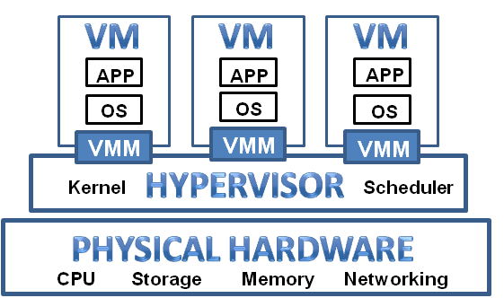
Application Virtualization
The application behaves as if it's installed locally, but it's actually executed from a remote server or a virtual container, isolating it from the OS.
Concept
Isolation of applications from the OS for flexibility and security.
Allows seamless deployment and management.
Data Exchange
Primarily exchanges structured data and API calls between virtualized apps.
Improves resource usage efficiency.

Slide 5

Data Types Transferred Between VMs
File Data
Large files, configuration data, logs shared over storage or networks.
Streaming Data
Real-time data streams like telemetry or video.
Messages & API Calls
Structured communication for application synchronization and control.
Shared Memory Data
Fast inter-VM communication using shared memory techniques.

Slide 6
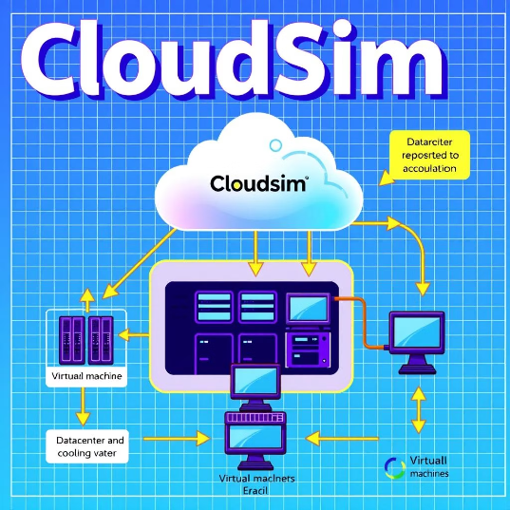
CloudSim Simulation Architecture
Key Components
Data Exchange Methods
CloudSim Framework manages the environment
Direct VM communication
Datacenter hosts virtual machines
Shared storage usage
Cloud Broker allocates tasks and data transfer
Network-based data transfer

Slide 7




Benefits and Optimizations Achieved
Reduced Latency
Simulations identify bottlenecks minimizing communication delays.
Improved Security
Simulated secure methods reduce vulnerabilities in data exchange.
Efficient Resource Use
Optimized data sharing improves bandwidth and CPU utilization.

Slide 8

Key Takeaways and Future Work
Apply to Real Systems
Enhance Realism
Translate simulation insights to optimize live cloud deployments.
Simulate Diverse Scenarios
Incorporate more accurate network and hardware characteristics.
Explore additional data exchange models and security protocols.

